Slide 1

IBM Cloud Pak for Data: Seller Enablement
Dirk deRoos
WW Technology Sales Enablement
Data and AI
dderoos@ca.ibm.com
Notes:
Let’s start by addressing the single biggest question clients ask when presented with Cloud Pak for Data,
“Why do we need a data and AI platform, and what are the benefits?”
It’s now commonly accepted that data is the foundation for businesses to drive smarter decisions. Data is what fuels digital transformation. But it’s Artificial Intelligence (AI) that unlocks the value of that data, which is why AI is poised to transform businesses with the potential to add almost 16 trillion dollars to the global economy by 2030. (Source: https://www.pwc.com/gx/en/issues/data-and-analytics/publications/artificial-intelligence-study.html)
However, the adoption of AI and data-driven decision making has been slower than anticipated. Business leaders not only need to understand the power of AI, but how they can fully unleash its potential and operate in a hybrid cloud world.
Cloud Pak for Data is a new kind of data and analytics platform with built-in governance. It simplifies and unifies how clients collect, organize, and analyze data to accelerate the value of data science and AI. This hybrid cloud data platform delivers a broad range of core data microservices, with the option to add more from a growing services catalog. The platform helps the client experience with greater flexibility, security, control, and the benefits of the cloud without having to move data.
This seller presentation showcases how IBM Cloud Pak for Data brings differentiated value to clients’ environments and helps anyone communicate this value.

Slide 2
Agenda
05 Packaging of base services, extended services and cartridges
11 Cloud Pak for Data as a Service
16 Market trends and the next generation of Cloud Pak for Data
17 Key resources
Notes:
This seller presentation covers:
Packaging of base services, extended services and cartridges, and the various deployment options
Market trends and the next generation of Cloud Pak for Data
Resources and assets to go deeper into product specifics
Key resources

Slide 3
Seller guidance and legal disclaimer
Slides in this presentation marked as "IBM and Business Partner Internal Use Only" are for IBM and Business Partner use and should not be shared with clients or anyone else outside of IBM or the Business Partners’ company.
© IBM Corporation 2024. All Rights Reserved.
The information contained in this publication is provided for informational purposes only. While efforts were made to verify the completeness and accuracy of the information contained in this publication, it is provided AS IS without warranty of any kind, express or implied. In addition, this information is based on IBM’s current product plans and strategy, which are subject to change by IBM without notice. IBM shall not be responsible for any damages arising out of the use of, or otherwise related to, this publication or any other materials. Nothing contained in this publication is intended to, nor shall have the effect of, creating any warranties or representations from IBM or its suppliers or licensors, or altering the terms and conditions of the applicable license agreement governing the use of IBM software.
References in this presentation to IBM products, programs, or services do not imply that they will be available in all countries in which IBM operates. Product release dates and/or capabilities referenced in this presentation may change at any time at IBM’s sole discretion based on market opportunities or other factors and are not intended to be a commitment to future product or feature availability in any way. Nothing contained in these materials is intended to, nor shall have the effect of, stating or implying that any activities undertaken by you will result in any specific sales, revenue growth, or other results.
All client examples described are presented as illustrations of how those clients have used IBM products and the results they may have achieved. Actual environmental costs and performance characteristics may vary by client.
IBM and Business Partner Internal Use Only
Notes:
This self-explanatory slide shares seller guidance and legal disclaimers for this presentation.

Slide 4
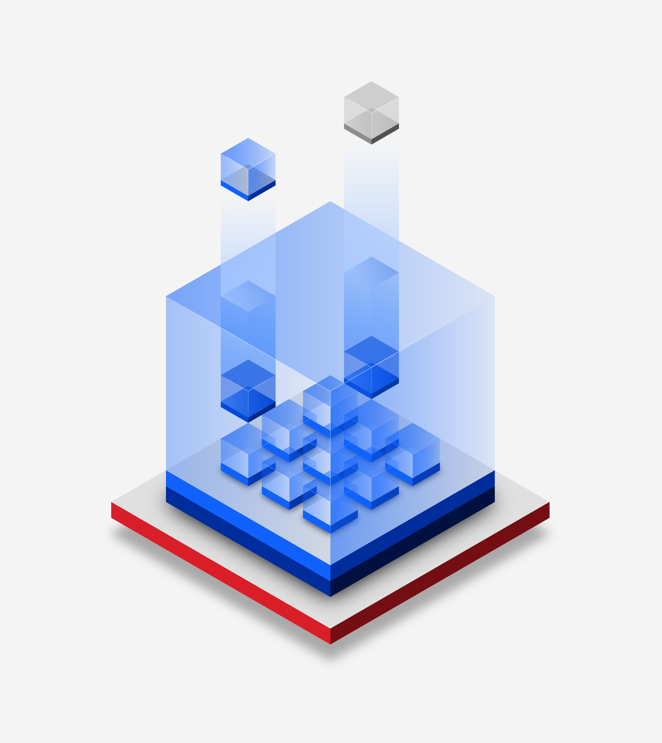

IBM Cloud Pak for Data Arquitectura de información para IA
IBM Cloud | Amazon Web Services | Microsoft Azure | Google Cloud | On-premises hardware
Cloud Pak for Data
Servicios de nube preintegrados de datos, IA, entregados dentro de una plataforma nativa en nube abierta y extensible
Data Management
Data Fabric
Business Analytics
Customer Care
Hybrid cloud platform
IBM Cloud
Amazon Web Services
Microsoft Azure
Google Cloud
On-premises hardware
Notes:
La arquitectura de información abierta de IBM para IA se basa en Cloud Pak for Data en Red Hat OpenShift, que es la pila completa de datos e IA de IBM, creada para un mundo de nube híbrida. ¿Qué significa esto? Esto significa que si un cliente está listo para implementar IA, Cloud Pak for Data ofrece un conjunto de datos preintegrados y servicios de IA, entregados dentro de una plataforma nativa en la nube abierta y extensa, que proporciona todas las capacidades necesarias para recopilar, organizar y analizar datos y luego infundir IA en las aplicaciones y procesos de un cliente.
El empaquetado y las licencias de la plataforma están diseñados para hacer dos cosas. En primer lugar, consolide el software y reduzca el gasto en herramientas. En segundo lugar, desbloquee un nuevo valor de la infraestructura existente ejecutándola en la plataforma de contenedores de Red Hat OpenShift.
Comenzando con el valor de la consolidación de la herramienta de la plataforma de datos, IBM proporciona a las empresas una mayor agilidad al proporcionar capacidades para administrar y analizar datos dentro de una sola plataforma, así como la capacidad de infundir IA en las aplicaciones. Ya no es necesaria la consolidación manual y la costosa integración de las nubes de la competencia; deje los datos donde están y Cloud Pak for Data puede conectarse y aprovechar esos datos para la IA. Un informe de Forrester Total Economic Impact señaló que las empresas de hoy en día tienen dificultades para gestionar soluciones puntuales múltiples. Algunos proveedores tienen capacidades en la nube, mientras que otros tienen IA y quizás pocas integraciones con la nube. La plataforma integrada de Cloud Pak for Data es abierta y accesible, lo que significa que puede ejecutarse en la parte superior de una nube pública y/o en las instalaciones conectándose a los datos donde residen.
Esto nos lleva al segundo punto, desbloquear un nuevo valor de la infraestructura existente. Una vez que los clientes tienen una base analítica lista para el negocio, se pueden explorar e implementar nuevos proyectos de crecimiento para obtener un ROI sustancial. Ya sea que los clientes deseen implementar una aplicación de código bajo y sin código para resolver sus problemas más difíciles de cadena de suministro u optimización (Referencia # 1), cumplir con los objetivos de cumplimiento regulatorio (Referencia # 2) o analizar cantidades masivas de datos no estructurados (Referencia # 3), las aplicaciones de IA de IBM basadas en Cloud Pak for Data pueden satisfacer sus necesidades.
Cloud Pak for Data puede ser consumido por un cliente como un sistema hiperconvergente con Cloud Pak for Data System, desplegado en la nube de su elección (Cloud Pak for Data) o gestionado completamente por IBM con Cloud Pak for Data as a Service. Todo esto es posible gracias a una arquitectura de microservicios que utiliza la plataforma de contenedores de Red Hat OpenShift. No existe una "talla única" en el entorno de TI moderno de hoy en día. Debido a esto, las empresas pueden beneficiarse de la compra de Cloud Pak for Data de una manera que las empodere para el futuro y se adapte a su viaje de modernización.
Sources
Forrester Total Economic Impact of IBM Cloud Pak for Data, February 2020, https://www.ibm.com/downloads/cas/V5GNQKGE
Reference 1 Source: https://ibm.seismic.com/Link/Content/DCuuFEMzs6AkmjSdWDs1zpfQ
Reference 2 Source: https://ibm.seismic.com/Link/Content/DCq_soeMgH-06x8klU6rguTQ
Reference 3 Source: https://ibm.seismic.com/Link/Content/DCAbLwvUmvBkikXH7Kirhphg
See all Cloud Pak for Data external client reference stories here on Seismic: https://ibm.seismic.com/Link/Content/DC4HXEVGb54kuF-mTTcl4yBg

Slide 5
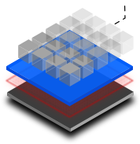
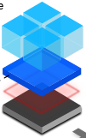
Cloud Pak for Data v4.8 Packaging Details on Base Platform Services, Cartridges, & Express Parts
Cloud Pak for Data Base Platform Services
Cloud Pak for Data Cartridges
Cloud Pak for Data Express
AI Factsheets
Analytics Engine for Apache Spark
Data Management Console
Data Privacy
Db2 Warehouse*
Db2 BigSQL
Decision Optimization
Hadoop Execution Engine
IBM Match 360
SPSS Modeler
IBM Knowledge Catalog
Watson Machine Learning Accelerator
Watson Machine Learning (including AutoAI)
Watson OpenScale
Watson Pipelines
Watson Studio (including Data Refinery
AI Governance**
Cognos Analytics
Cognos Dashboards
Data Replication
DataStage
Db2
Db2 Warehouse*
Financial Crimes Insights
Financial Services Workbench
Information Server
Informix
Knowledge Accelerators
Manta
Master Data Management
Open Data for Industries
OpenPages
Planning Analytics
Product Master
Watson Assistant
Watson Discovery
Watson Speech Services
ELT Pushdown Express
Data Governance Express
Data Science & MLOps Express
*Db2 Warehouse is available as a base service as a Cartridge (Cartridge list price is less than CP4D EE list price)
**AI Governance is a bundle solution, not a cartridge
Notes:
This packaging slide focuses on Cloud Pak for Data Software. Cloud Pak for Data’s base services largely span the four Data and AI solution areas: Data Management, Data Fabric, Business Analytics, and Customer Care, allowing clients “out of the box” access to connect to data wherever it resides. There is no need for data movement with Cloud Pak for Data’s Data Virtualization (DV) capability and data source connectors. Cloud Pak for Data’s expanded capabilities enable enterprises to maintain a true data fabric. After data is connected and governed, clients benefit from a trusted business ready foundation for analytics.
Watson Studio is IBM’s Integrated Development Environment (IDE) that allows for highly skilled data scientists or citizen data scientists (analysts without significant AI programming skills) to build, run, and manage AI models, and deploy them using Watson Studio’s deployment service. Watson Studio provides “low code” graphical interfaces for analyzing data, as well as programmatic tools like Jupyter Notebooks to build AI models. Products like SPSS Modeler and Decision Optimization (previously packaged as a Cloud Pak for Data Cartridge) are included in the base Cloud Pak for Data version 4.5 enrichment, thus provide greater value for clients looking to use Cloud Pak for Data for Trusted AI use cases.
IBM has an extensive suite of Original Equipment Manufacturer (OEM) partnerships to expand upon base services like open-source databases (EnterpriseDB, MongoDB, DataStax, among others). While not covered in this presentation, IBM has new OEM partnerships with Anaconda and Palantir to offer ever greater capabilities with OEMs beyond the base services.
For clients ready to deploy Customer Care Applications, IBM offers many Watson applications as “Cartridges”. More details on Data and AI brand’s AI Applications are covered in other presentations.

Slide 6
¿Qué es un cartridge?
AI and Data Cartridges
Data Fabric
Data Management
Financial Crimes Insights
Openpages
Open Data for Industries
Financial Services Workbench
Data Replication
Master Data Management
Product Master
DataStage
Information Server
Knowledge Accelerators
Db2 AE/SE
Informix
Db2 Warehouse
Producto en contenedor(Cartridge)
Cloud Pak for Data
Restricted Red Hat OpenShift
Business Analytics
Customer Care
Cognos Analytics
Planning Analytics
Cognos Dashboards
Watson Assistant
Watson Discovery
Watson Speech Services
Derecho compartido con el producto tradicional / no contenedor Métrica de carga: VPC Tipos de piezas: Perpetuo, Suscripción
Notes:
¿Qué es un Cloud Pak para cartucho de datos? En pocas palabras, un cartucho de Cloud Pak para datos ofrece capacidades ampliadas además de un número ya extenso de servicios básicos dentro de Cloud Pak para datos. Los cartuchos son un derecho todo en uno para el software restringido Red Hat OpenShift y Cloud Pak for Data Enterprise Edition. Esto significa que cuando un cliente compra un cartucho, puede::
Aproveche OpenShift para implementar en la infraestructura de su elección
Modernice las cargas de trabajo con software en contenedores
Tener acceso a todos los servicios básicos
Modernice a su propio ritmo con derechos compartidos (es decir, la cantidad de licencias compradas que un cliente elige ejecutar de forma independiente o en contenedores)
La estrategia de derechos compartidos de un cartucho permite diferentes escenarios de implementación que van desde la no contenedorización inicial, la contenedorización parcial hasta la contenedorización completa. La métrica de carga de un cartucho es IBM Virtual Processor Core (VPC). En el caso de una nueva licencia o cliente neto, los clientes recibirán una cantidad fija de VPC equivalentes (a través de una relación de conversión de la métrica de cargo no contenedorizada). Depende del cliente determinar qué grado de contenedorización (la asignación de VPC entre el producto independiente y el producto en contenedores) le gustaría.
A la derecha de esta diapositiva se encuentra el Cloud Pak para cartuchos de datos.

Slide 7
When to sell cartridges and why
Sell cartridges for all new license sales
Existing clients with new workloads or expanding volumes
New clients
Comparing to standalone products, cartridges offer:
Equivalent pricing
Future-proof with new functionality and entitlement model
Deployment flexibility from legacy on-prem to any Cloud
Avoid extra approval in the bid process
Partners receive 10% incentive for selling cartridges
IBM Cloud | Amazon Web Services | Microsoft Azure Google Cloud | On-premises hardware
Notes:
When should a Cartridge be sold to a client?
Cartridges should be proposed for new clients or existing clients looking for a net new license (for example, a new use case or expanding volume). Standalone proposals (no Cartridge Is part of the deal) will incur an additional internal approval process.
What’s the value to the client?
By proposing a Cartridge, clients are enabled to meet their existing needs while also expanding future opportunities to modernize other workloads onto a containerized environment. If a client shares that they are not ready for a fully containerized solution, address the shared-entitlement scenario where they can continue to use their standalone products and move to containerized versions of their product at their own pace. The shared-entitlement scenario is also optimal for clients that requires features not yet available within Cloud Pak for Data.
IBM Business Partners also receive a 10% incentive for selling Cloud Pak for Data Cartridges.

Slide 8
What is shared entitlement, and how does it work?
1
No Containerization
Client ops to run Db2 standalone (Bare Metal/VM)
Db2
Standalone | Containerized
100 VPCs
 | 0 VPCs
Example
Consider a client who purchases 100 VPCs of Db2 AE/SE Cartridge
2
Partial Containerization
Client starts containerizing Db2. The total VPC count cannot exceed their entitlement
Db2
Standalone | Containerized
60 VPCs
 | 40 VPCs
3
Full Containerization
Client containerizes their entire Db2 estate on Cloud Pak for Data
Db2
Standalone | Containerized
 | 100 VPCs
0 VPCs
All three of these deployment strategies are fully supported
Notes:
Let’s dive deeper into the shared-entitlement concept. This slide illustrates a scenario for the Db2 Cartridge for a net new client or an existing client deploying a net new workload.
The left side of this slide illustrates a client who has no containerization of the standalone product; this means that this client is able to consume all 100 Virtual Processor Cores (VPCs) equivalent of Db2 on Bare Metal or a VM (virtual machine).
In the middle, is a client using partial containerization of standalone Db2. Of the 100 VPCs purchased, this client chooses to consume only 60 VPC equivalent of Db2 as standalone, while containerizing 40 VPCs in Cloud Pak for Data. The total VPC count cannot exceed their entitlement of 100 VPCs.
Finally on the right is a full containerization scenario. This client has opted to containerize their entire Db2 estate and deploy on Cloud Pak for Data, based on their initial 100 VPC equivalent starting point. For more details on this Db2 Cartridge scenario, visit the full illustration deck on Seismic at: https://ibm.seismic.com/Link/Content/DCgHBG7lUVV06_qM7xZaaTJg.
With Cloud Pak for Data Cartridges, a client is in control of when they modernize. The role of any IBM seller or Business Partner is to help clients determine the appropriate amount of initial containerization. IBM offers Expert Lab engagements focusing on Data Warehouse and Data Science use cases, as well as AI Apps workshops to assist the scenario. Learn more about these programs on Seismic at: https://ibm.seismic.com/Link/Content/DCE9YHoqiZW0aYQCClu49AYA.

Slide 9
What is a modernization upgrade?
For existing clients prior to S&S renewal
Shared entitled with traditional/non-container product (no immediate workload migration needed)
Charge metric: VPC
Part types: Perpetual (Trade-up), Subscription (Upgrade)
Cartridge
+
Cloud Pak for Data Enterprise Edition
Note: Modernization parts being deprecated Q3 2024. See slide 11!
Notes:
Modernization Upgrade
What if 1+1 equaled more than 2? That’s the idea of a Modernization Upgrade: to create a whole that is worth more than the sum of its parts. But first, let’s explore why it’s called a Modernization Upgrade. It all ties back to Red Hat OpenShift and providing versatility with every service. Meaning, if a client is on a journey to AI, Cloud Pak for Data offers a set of pre-integrated data and AI services, delivered within an open and extensive cloud-native platform, giving clients all the capabilities needed to collect, organize, analyze data, and then infuse AI into applications and processes. By deploying on Red Hat OpenShift, clients can simplify operations and add flexibility for a hybrid cloud world.
Clients running legacy point solutions will benefit from a common interface, single-user authentication, and improved governance and security when they choose to modernize their estates. The integration within Cloud Pak for Data and interoperability of base services further enhances a client’s current workloads, while opening the door for expanded outcomes across the enterprise. Thus, clients can experience greater efficiencies on the platform today while unlocking new pathways to leverage and deploy AI in a way that single point solutions cannot.
So what does an existing client get when they upgrade from their current standalone software products? Existing clients, prior to Subscription and Support (S&S) renewal, can trade-in their existing licenses of a stand-alone product and receive two things. First is the same number of Virtual Processor Cores (VPCs) of the modernized software license (Cartridge) plus the equivalent number of Cloud Pak for Data VPCs. This means clients can start using Cloud Pak for Data immediately, and while executing an upgrade, clients can continue to leverage their existing services wherever they are. clients have the flexibility to choose when and how many existing services to containerize, via a shared entitlement. There is a separate scenario where a client can exchange their existing services for even more Cloud Pak for Data base VPCs at a set multiplier.
More details on the conversion ratios and scenarios can be found on Seismic at: https://ibm.seismic.com/Link/Content/DCmw9Rux5dDU-tRjGVlU6vow.

Slide 10
When to sell a modernization upgrade, and why
Sell a modernization upgrade to existing clients prior to S&S renewal for eligible products
Offered as:
1
Perpetual Trade Up
10% S&S uplift + license fee for perpetual licenses
Larger deal > more margins
A larger deal and highly cost-effective way for clients to meet current and future business needs
Future-proof with new functionality and entitlement model with cartridge license
Implement data virtualization, data governance, data science etc. with Cloud Pak for Data
Flexibility in licenses, deployment models, and entitlement allocation across existing on-prem deployment and/or containerized deployment to any Cloud
2
Subscription (CTL) Upgrade
35% S&S uplift for subscription license
Larger deal and more upfront payment, especially with multi-year subscription
Land and expand with the platform
Note: Modernization parts being deprecated Q3 2024. See slide 11!
Notes:
When should a Modernization Upgrade be sold to a client?
Remember, a modernization upgrade is for existing clients that are running a legacy or stand-alone product offered as a Cartridge. The modernization upgrade must happen prior to Subscription and Support (S&S) renewal. To view which services are eligible for a modernization upgrade, visit the Seismic Modernization Upgrade Campaign page at: https://ibm.seismic.com/Link/Content/DCtYvup8OwyUKTvZPRfwXIGA.
What’s the value to clients?
Beyond modernizing their IT for hybrid cloud and AI workloads, there are immediate financial benefits of upgrading. To a client, a modernization upgrade is the most cost effective method to meet current and future business needs. IBM Global Financing (IGF) is also available if the client has a desire to finance their purchase.
According to a 2020 Forrester Total Economic Impact (TEI) Report, the quantified projected benefits to a large multi-national organization are the following:
Containers and container management efficiencies totaling $12.5 million to $14.4 million ($US)
Data virtualization benefits totaling $932,569 to $2.4 million ($US)
Data science, Machine Learning (ML), and AI benefits totaling $1.2 million to $3.4 million ($US)
(Source: Forrester Total Economic Impact of IBM Cloud Pak for Data, February 2020, https://www.ibm.com/downloads/cas/V5GNQKGE.)
Executing a Modernization Upgrade Sale
Ready for the numbers? IBM Sellers can use the Modernization Engine (formerly known as the Modernization Calculator) in the Software Quote and Order (SQO) tool, and Business Partners can use it in the Partner Guided Selling (PGS) tool. The Modernization Engine eases the bid process and configures a bid based on a client’s install base. Have questions? IBMers can message in Slack (#cloudpakfordata) and Business Partners should contact their IBM representative.
For the latest information and assets, visit the Modernization Upgrade Campaign page in Seismic at: https://ibm.seismic.com/Link/Content/DCtYvup8OwyUKTvZPRfwXIGA.
Finally, see the Proposal Templates by Cartridge at: https://ibm.seismic.com/Link/Content/DCtYvup8OwyUKTvZPRfwXIGA#/?anchorId=6fdba4b4-99ca-41f9-88a3-d20fcc68d5af.
Definitions:
Subscription license upgrade: Formerly known as Committed Term License (CTL) upgrade - A 35% uplift in annual subscription over the client’s Subscription and Support (S&S) last price paid (LPP).
Perpetual trade-up: An uplift in annual subscription over a client’s S&S and LPP, plus a one-time perpetual license trade-up fee.

Slide 11
NEW: Modernization Parts are retiring soon, Cloud Pak for Data Cartridges will take their place
1
Existing clients will be able to continue to renew their entitlements, no new sales of Modernization parts.
2
Clients who still want to trade up their software to Cloud Pak for Data Cartridges will be able to do so with new upgrade and trade-up parts
Sunset
Keep
New Parts
Modernization Trade-ups
Cartridge Perpetual Trade-Ups
+
Modernization Renewals
Modernization SL Upgrades¹
Cartridge Subscription License Upgrades
Notes:
Changes effective Q3 2024:
No bonus core of Cloud Pak for Data with Cartridge parts
No option to deploy extra Cloud Pak for Data if the Cartridge software is unused
Trade-Ups and SL Upgrades to Cartridges are the same price as Modernization equivalent
¹ Clients currently on subscription license upgrades will be able to renew their entitlements

Slide 12
Why Cloud Pak for Data as-a-Service?
Quick Deployment
AI and Data services deploy nearly instantly from the Cloud Pak for Data catalog, with the click of a single button.
Zero Maintenance
All services are fully managed by IBM, taking away all of the burdens of managing IT infrastructure and apps. If something goes wrong, it’s on IBM.
Always up to date
Software updates are deployed on a regular basis (weekly or monthly) ensuring access to the latest and greatest capabilities across the platform
Infinitely Scalable
Additional cloud infrastructure and resources, like compute, storage, and memory are always a button click or API call away, or stretch/scale automatically
Multi-cloud available
Services are rolling out across other cloud vendors, allowing users to run IBM managed services on IBM Cloud, AWS, Azure, and Google Cloud
Pay for what you use
Pricing by hour or minute ensures that the client is only charged for services that are consumed, and only for the time they are consumed
Notes:
Why Cloud Pak for Data as a Service?
Cloud Pak for Data as a Service is fully managed by IBM. For clients, this means a “hands off” approach and incredibly quick time to deployment. This platform and its services deploy instantly from the catalog. What’s more, there is zero maintenance required by clients, it’s all taken care of by IBM. Next, the software is always up to date, an inherent attribute to running a SaaS (Software as a Service) product. A client’s IT department does not need to update and install the “latest and greatest”, it’s automatically pushed on a weekly or monthly basis to clients running as a service. And because the platform is running on cloud, resources like compute, storage and memory can scale to meet their needs and additional capacity is only a click away.
A recent Gartner survey of public cloud users found that “81% of respondents using two or more [cloud] providers.” Services within Cloud Pak for Data as a Service are rolling out across other cloud vendors. In the future, Cloud Pak for Data as a Service will be available for purchase and deployment on other hyperscalers, with all the benefits of being fully managed by IBM.
Lastly, and perhaps most important, clients only pay for what services they use. This is called consumption-based pricing and is a key differentiator from other deployment options for Cloud Pak for Data. Clients that may not be ready to commit to a perpetual license can enjoy the benefits of the platform while paying for only what services are consumed, in a cloud native pricing model.
(Source: Gartner, 2020, https://www.gartner.com/en/conferences/apac/infrastructure-operations-cloud-india/gartner-insights/swg-why-organizations-choose-a-multicloud-strategy.)

Slide 13









¿Qué pueden hacer los clientes con estos servicios?
Construya, ponga en funcionamiento y gobierne la IA
Watson
Studio
Watson
OpenScale
Watson Machine Learning
IBM Knowledge Catalog
OpenPages on AWS
Combinaciones destacadas de servicios para formar Soluciones de misión crítica para clientes
Proporcione acceso a todos sus datos sin moverlos
DataStage
Data
Replication
Data Virtualization
IBM Knowledge Catalog
Crea una vista de 360 grados de los datos de los clientes
Comparte, enriquece y gobierna los datos
Match 360
IBM Knowledge Catalog
Data Virtualization
IBM Knowledge Catalog
Notes:
¿Qué pueden hacer los clientes con Cloud Pak for Data as a Service? Hay muchos casos de uso posibles disponibles hoy en día para Cloud Pak for Data as a Service. La lista de esta diapositiva, aunque no es exhaustiva, muestra las necesidades comunes de los clientes y los servicios que se deben seleccionar para habilitar el caso de uso asociado. En este escenario exploratorio, Cloud Pak for Data as a Service permite a los clientes empezar a trabajar rápidamente.
More services are constantly being added to the Cloud Pak for Data catalog. Visit the Cloud Pak for Data Sales Kit on Seismic to view the roadmap and full list of services at: https://ibm.seismic.com/Link/Content/DCsp7rvvYS70yP9lLtipgL1A.
View existing data fabric tutorials at: https://dataplatform.cloud.ibm.com/docs/content/wsj/getting-started/df_tutorials.html?context=cpdaas&audience=wdp

Slide 14
Cloud Pak for Data – Closing the software and SaaS parity gap
Available on Software and As-a-Service
Available on Software
Available As-a-Service
Watson Studio
IBM Knowledge Catalog
Watson Discovery
Watson Machine Learning
Watson OpenScale
Watson Assistant
Data Virtualization
DataStage
Speech-to-Text
Text-to-Speech
Db2 Warehouse
Db2
Databases for EDB
Databases for PostgresSQL
Databases for MongoDB
IBM Dashboards
Analytics Engine
Match 360
Informix
Cognos Analytics
Planning Analytics
Databand
OpenPages
Watson Knowledge Studio
Execution Engine for Apache Hadoop
Data Refinery*
Decision Optimization*
Data Privacy*
Virtual Data Pipeline
Voice Gateway
Db2 Data Management Console
Watson Assistant for Voice Interaction
Watson Machine Learning Accelerator
Db2 Data Gate
Db2 Big SQL
SPSS Modeler
Product Master
Watson Studio
Watson Assistant
IBM Knowledge Catalog
Watson Machine Learning
Match 360*
Data Virtualization
Netezza
Cloudant
Cloud Object Storage
Watson Tone Analyzer
Language Translator
Natural Language Understanding
Data Engine
Databases for Elasticsearch
IBM Dashboards
Data Replication
Event Streams
Secure Gateway
Notes:
Regarding roadmaps and parity between Software as a Service (SaaS) and software, there are some gaps to address around capabilities found in the on-premises product that are not yet complete in the SaaS product. This self-explaining slide addresses the parity gaps and planned rollout for 2022/2023.
Moving forward, IBM is committed to a cloud-first delivery model for Cloud Pak for Data, where new features will roll out in an ongoing basis in the as a service offering first. Cloud Pak for Data as a Service will also receive more frequent updates (weekly or monthly basis) while Cloud Pak for Data Software will move to a twice a year release cycle. This future delivery strategy makes the modernization approach to Cloud Pak for Data even more compelling.
More services are constantly being added to the Cloud Pak for Data catalog.
*Match 360 is available as a lite plan, with plans for full SaaS in the roadmap.
Link to source: CPD- CPDaaS Catalog Comparison.PPTX

Slide 15
How the consumption-based pricing model works
Example: Client purchases a 12-month subscription ($100/mo x 12 mos = $12000 annual contract value (ACV)
}
Watson Studio
$15/mo
$100 /mo
Db2 Warehouse
$30/mo
$15 Remaining
Object Storage
$40/mo
Client purchases a subscription to Cloud Pak for Data as a Service totaling an amount of money necessary to run the set of services the client wants to run.
Client provisions the set of cloud services that will form their specific solution (i.e. Watson Studio + Cloud Object Storage + Db2 Warehouse).
Each service draws down on that subscription, consuming the purchased credits at its own rate (i.e. Db2 Warehouse consumes the subscription at $7.76/hr for an instance).
If a client runs out of credits by end of term, they’ll either go into overage mode (and pay a premium) or call up their favorite sales rep to purchase more credits.
Any unconsumed credits for the month roll over to the next month.
Notes:
How does consumption-based pricing work?
This slide answers what a client purchases and how consumption works in the as a service product. Let’s walk through this illustrated example. In this example a client purchases a Cloud Pak for Data as a Service subscription that total the amount of services the client is planning to utilize. The subscription is a single part number, and in this example, a client has purchased a 12-month subscription totaling $1,200 in annual contract value (ACV), or $100/month.
This client is able to log into their account and select their services mix from the catalog. The client has chosen Cloud Object Storage, Watson Studio, and Db2 Warehouse totaling $85/month. Each of these three services start drawing down from the $1,200 subscription purchased. It’s important to note that each service consumes the purchased subscription at their own rate. Within Cloud Pak for Data as a Service, a client can easily view the consumption and where they stand for their term in terms of available service consumption.
The rate at which a client consumes services is up to them. In practical terms, a client could consume $500 in month 1 and still have $700 in credit remaining for the remainder of the term (in this case 1 year). Any unused credits will roll over from month to month within the existing 12-month subscription. If a client purchased a multi-year subscription (i.e. multiple 12-month terms), the unused credits from year 1 will not roll over into future years. Conversely, if a client uses up their entire 12-month credit in the first few months, this will be billed as an overage and the client will have to pay a premium to consume more within the same 12-month term. Any 12-month term credits (from the original subscription or overage) will not roll over into the next 12-month term.

Slide 16
Is Cloud Pak for Data as a Service right for a client?
Cloud Pak for Data Software
Cloud Pak for Data as a Service
Runs on any cloud, including on-prem
Self-managed, optional deployment automation
VPC based (Committed Term or Perpetual License)
Integration provided in platform across services
Runs on IBM Cloud
Fully managed by IBM
Usage (API calls, users, etc) based (SaaS Subscription)
Integration provided in platform across services
Best for:
Need a platform to catalog, govern, transform, and analyze data
Have requirements for greater isolation and customization (security, availability, etc.)
Have skills to leverage in the solution components (OpenShift, Db2, Cognos, etc.)
Best for:
Standardized on as-a-service for data driven workloads
Need flexibility and speed
Need a turnkey solution with compliance
Don’t have the skillset or desire to manage the software stack
Notes:
The table on this self-explaining slide highlights, at a high level, which deployment of Cloud Pak for Data may be the first option to propose depending on a client’s needs. Remember, clients might decide to consume benefits of both versions.
VPC = Virtual Processor Core, the charge metric for Cloud Pak for Data Software licensing.

Slide 17
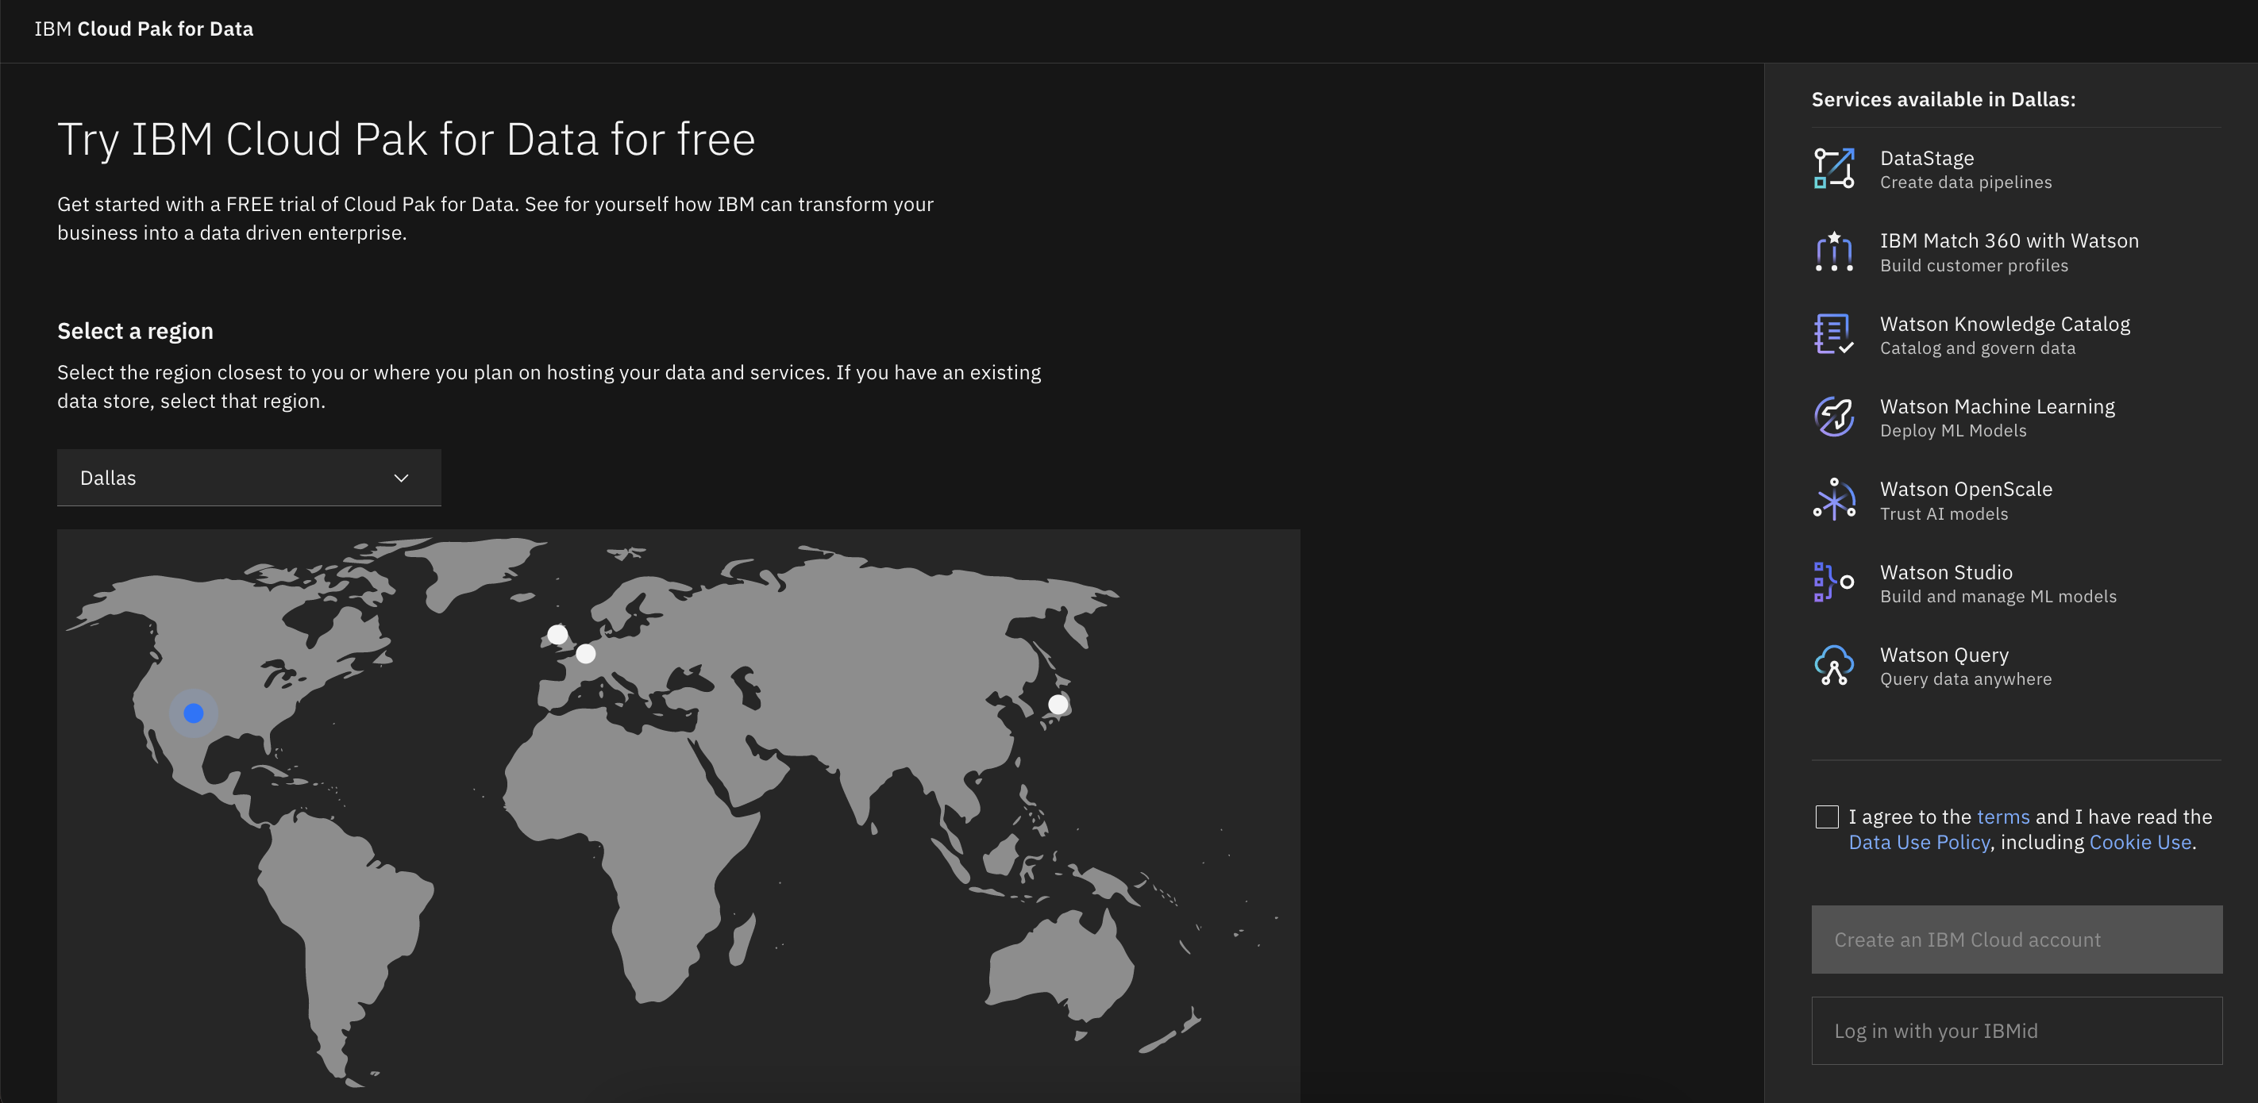
Trial for Cloud Pak for Data as a Service
→ http://dataplatform.cloud.ibm.com
Notes:
IBM also offers a free trial of Cloud Pak for Data as a Service with access to all Lite services, and many new services from the catalog. There is no commitment when test driving Cloud Pak for Data as a Service. IBM encourages customers to see for themselves the power of this product, perhaps with a small pilot project within a particular line of business.
Using the link provided on this slide (dataplatform.cloud.ibm.com), clients can quickly get started today with Cloud Pak for Data as a Service.
To view all currently available services, visit IBM’s online documentation at: https://dataplatform.cloud.ibm.com/docs?context=cpdaas.
To view the latest services and what’s new in Cloud Pak for Data as a Service, view the “What’s New” section of the online documentation at: https://dataplatform.cloud.ibm.com/docs/content/wsj/getting-started/whats-new.html?context=cpdaas&audience=wdp.

Slide 18
Go-to market
Digital transformation: 3 Mega Trends
Move to inter-cloud
Hybrid data architecture for BI and AI
Data Lake & Data Warehouse
Convergence to a single query engine, decoupled from storage to support enterprise BI and AI
AI Governance
AI lifecycle to support end-to-end Governance, Risk and Compliance (GRC)
Hybrid Cloud Data Fabric
Modern Data Warehouse
End-to-end governance and privacy
Notes:
The next generation of Cloud Pak for Data will fully enable new use cases. IBM is positioning Cloud Pak for Data in three ways:
A Hybrid Cloud Data Fabric
Modern Data Warehouse
End-to-End Governance and Privacy (Trusted AI)
Let’s explore each of these themes in greater detail, and how Cloud Pak for Data enables each outcome.
A Hybrid Cloud Data Fabric
Forrester defines data fabric as “Orchestrating disparate data sources intelligently and securely in a self-service manner, leveraging data platforms such as data lakes, data warehouses, NoSQL, translytical and others to deliver a unified, trusted and comprehensive view of client and business data across the enterprise to support applications and insights.”
(Source: https://www.forrester.com/report/Enterprise+Data+Fabric+Enables+DataOps/-/E-RES153219.)
Clients that say they are “multi-cloud” talk about accessing data from multiple cloud independently; Cloud Pak for Data can talk to any cloud from one place. Think of Cloud Pak for Data as one level higher than a traditional cloud where data and access are brought together (the fabric) to enable fast insights and a comprehensive view of an enterprise’s data. The end goal of a data fabric is to intelligently integrate enterprise data for timely insights and business decisions, improved client experience, increased competitive advantage and faster innovation and growth.
Modern Data Warehouse
For clients, a robust data warehouse with great speeds and feeds is nothing new and considered mandatory. To be set apart, IBM must differentiate as a Modern Data Warehouse that brings value beyond fast query times and scalable storage. In December 2020, Gartner recognized IBM as a leader in Cloud Database Management Systems, specifically calling out Db2 Warehouse for Cloud Pak for Data. IBM’s solution empowers clients to modernize their data estate with Cloud Pak for Data, and immediately gain value from having centralized access as they pursue new analytical projects and seek ROI from growth projects. With a “single pane of glass” view into their data, clients move themselves into a stronger Artificial Intelligence (AI) position. In the words of a current client, "The ability for us to run the integrated analytics of Db2 across our expansive landscape of public and private clouds has enabled us to bring Machine Learning to many more areas of our business.” (Executive Vice President of Business Intelligence for AMC Networks. Source: IBM, 2020, https://newsroom.ibm.com/2020-12-02-IBM-Positioned-as-a-Leader-In-2020-Gartner-Magic-Quadrant-for-Cloud-Database-Management-Systems.)
End-to-End Governance and Privacy (Trusted AI)
Companies today are struggling to manage and maintain a multitude of data sources spanning public, private, and on-premises clouds. The Global AI Adoption Index 2021 found 75% of global respondents surveyed stated their company is pulling from over 20 different data sources that feed their AI, BI and analytics systems. In addition, one third of those respondents cited this data complexity and siloes as top barriers to AI adoption.
(Source: IBM, 2021, https://newsroom.ibm.com/image/IBM%27s+Global+AI+Adoption+Index+2021_Executive-Summary.pdf.)
Cloud Pak for Data’s analytics capabilities build upon a hybrid cloud data fabric to empower data analysts and data scientists with access to all data, no matter where it resides. Watson Studio and Watson Machine Learning provide the tools to build, run, deploy, and manage AI models. All with trust and transparency into their AI with Watson OpenScale. Clients desperately want to move away from a “wild west of data science” to a state of governed data and compliance. A recent European Union (EU) press release discussed the need for AI models and decisions to be explainable and not create or reproduce bias. Enterprises that fail to do so may have heavy fines or penalties levied against them for non-compliance. This need for explainability is not limited to just the EU. Watson OpenScale is a leader in AI explainability and detecting model bias, and it’s all included within Cloud Pak for Data.
(Source: European Commission, Section #1 2021, https://ec.europa.eu/commission/presscorner/detail/en/QANDA_21_1683.)

Slide 19

Key Resources
Demos
Live Demos and Technical Labs →
Environments (TechZone) →
Cloud Pak for Data as-a-Service →
Seismic
Cloud Pak for Data Sales Kit →
Modernization Upgrade Campaign →
Sales tools
External Business Value Experience →
Sales Configurator →
Client materials
Marketing Page →
Proposal Template →
Notes:
This self explaining slide lists useful links regarding resources to assist in the selling of Cloud Pak for Data.
Links:
Demos
https://cp4d-outcomes.techzone.ibm.com
https://techzone.ibm.com/collection/data-ai-live-demos-collection#tab-1
https://dataplatform.cloud.ibm.com/login
Seismic
https://ibm.seismic.com/Link/Content/DCsp7rvvYS70yP9lLtipgL1A
https://ibm.seismic.com/Link/Content/DCtYvup8OwyUKTvZPRfwXIGA
Sales tools
https://viewer.mediafly.com/ibm
https://app.ibmsalesconfigurator.com/#/
Client materials
https://www.ibm.com/products/cloud-pak-for-data
https://ibm.seismic.com/Link/Content/DCzOJSixVtpUiNDzmSB1nDOQ

